Slide 1


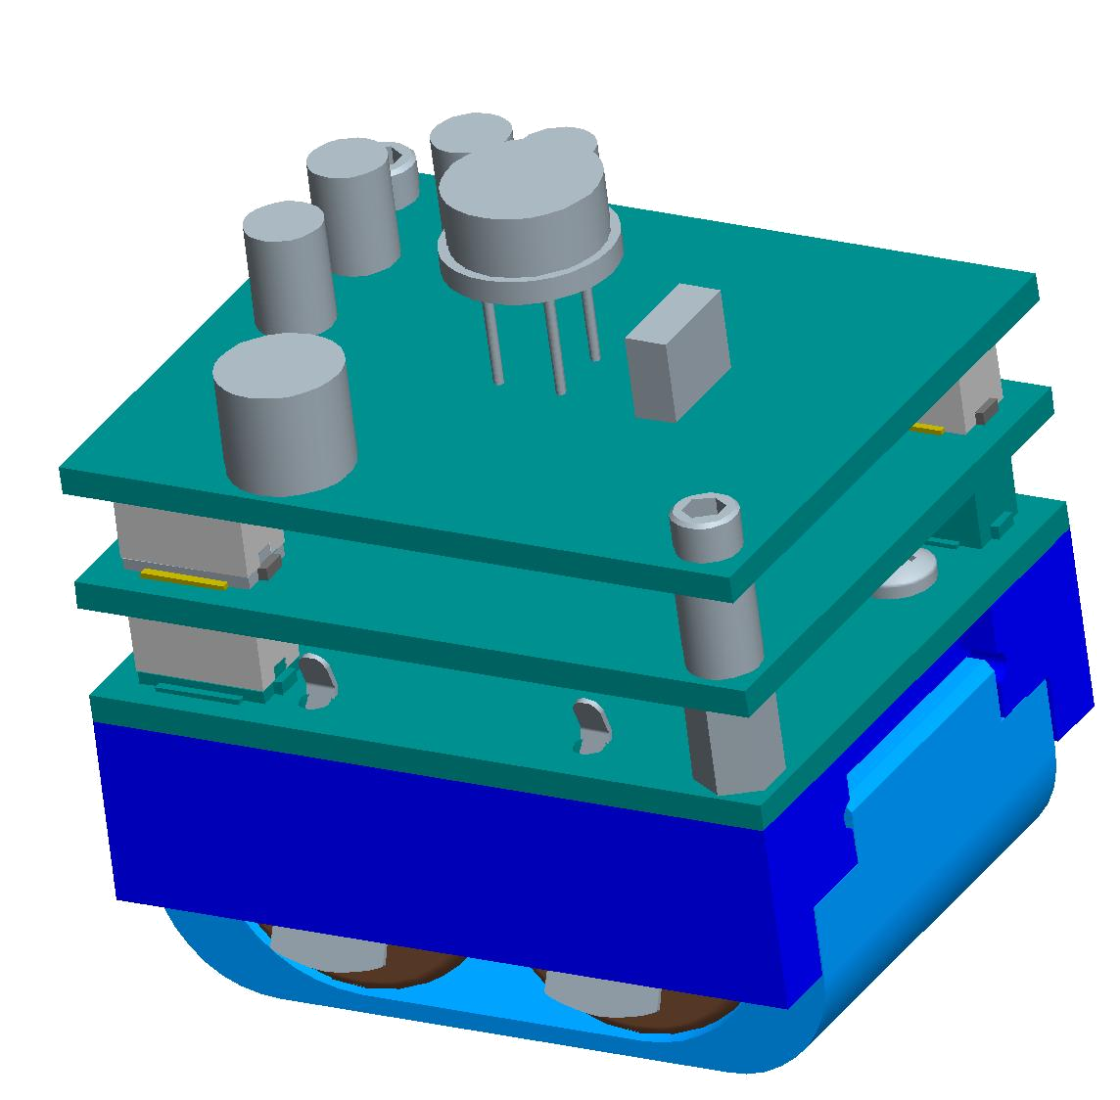
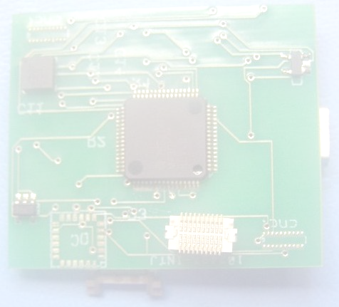
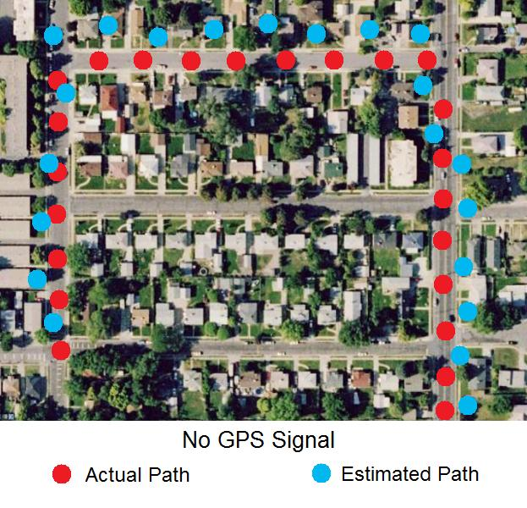
Development of a Tracking System
Purpose
Technical Requirements
Create a circuit that can be used to record and track the position of an object. This device will be used to answer the following questions.
Where are you now?
How did you get there?
Did you leave the approved path?
Board size of 38 mm by 32 mm
Height of 1.5 mm on bottom and 3.5 mm on top
Low power consumption
Be compatible with other circuit boards on the stack
Use GPS and “Dead Reckoning” to track position
Design
Expected Results
A GPS receiver and other components such as an
accelerometer, digital compass and a microprocessor
have been chosen. An initial circuit has been designed
using Eagle software. Basic programming of the
microprocessor has also been completed.
When completed, the device should be able to accurately track and store the path taken by an object.
Industry Sponsor
Sandia National Laboratories
Student Team
Jim Bullough, Trevor Meier, Bobby McNeal
Faculty Advisor
Cameron Charles
2008

